Slide 1
OPERATING SYSTEMS
Module 2 OS Principles
Dr. P. Subbulakshmi,
VIT Chennai
Dr.P.Subbulakshmi,VIT,Chennai

Slide 2
Networking Principles and layered architecture
Process Concept
Structures
  Process Control Block
  Ready List
  Threads
Operations on Processes
  Process Creation
  Process Termination
Dr.P.Subbulakshmi,VIT,Chennai

Slide 3
ADDRESSED COURSE OUTCOME
CO-2 : Apply various types of system calls and to find the stages of various process states.
Dr.P.Subbulakshmi,VIT,Chennai

Slide 4
Process
An operating system executes a variety of programs:
  Batch system – jobs
  Time-shared systems – user programs or tasks
Process – a program in execution; process execution must progress in sequential fashion
Dr.P.Subbulakshmi,VIT,Chennai

Slide 5
Process Contd.,
Parts of Process
  Text Section: Program code
  Current activity including program counter, processor registers
  Stack containing temporary data
    Function parameters, return addresses, local variables
  Data section containing global variables
  Heap containing memory dynamically allocated during run time
Dr.P.Subbulakshmi,VIT,Chennai

Slide 6
Process (Cont.)
Program is termed as passive entity which stores on disk whereas process is active entity. Once the executable file gets loaded into memory then program will be termed as process
Execution of program started via GUI mouse clicks, command line entry of its name, etc
One program can be several processes
  Consider multiple users executing the same program
Dr.P.Subbulakshmi,VIT,Chennai

Slide 7

Process in Memory
Source: Operating_System_Concepts,_8th_ Edition
Dr.P.Subbulakshmi,VIT,Chennai

Slide 8

Process State
  new: The process is being created
  running: Instructions are being executed
  waiting: The process is waiting for some event to occur
  ready: The process is waiting to be assigned to a processor
  terminated: The process has finished execution
Source: Operating_System_Concepts,_8th_ Edition
Dr.P.Subbulakshmi,VIT,Chennai

Slide 9

Process Control Block (PCB)
PCB Fields:
Process state – new, ready, running, waiting and so on
Program counter – address of the next instruction to be executed
CPU registers – contents of all process-centric registers
CPU scheduling information- priorities, scheduling queue pointers
Memory-management information – memory allocated to the process
Accounting information – CPU used, clock time elapsed since start, time limits
I/O status information – I/O devices allocated to process, list of open files
Source: Operating_System_Concepts,_8th_ Edition
Dr.P.Subbulakshmi,VIT,Chennai

Slide 10

CPU Switch From Process to Process
Source: Operating_System_Concepts,_8th_ Edition
Dr.P.Subbulakshmi,VIT,Chennai

Slide 11
Threads
A basic unit of CPU utilization, consisting of a program counter, a stack, and a set of registers, ( and a thread ID. ) Traditional ( heavyweight ) processes have a single thread of control –
  There is one program counter, and one sequence of instructions that can be carried out at any given time.
Consider having multiple program counters per process
  Multiple locations can execute at once
    Multiple threads of control -> threads
Must then have storage for thread details, multiple program counters in PCB
Dr.P.Subbulakshmi,VIT,Chennai

Slide 12

Process Representation in Linux
Represented by the C structure task_struct
pid t_pid; /* process identifier */
long state; /* state of the process */
unsigned int time_slice /* scheduling information */
struct task_struct *parent; /* this process’s parent */
struct list_head children; /* this process’s children */
struct files_struct *files; /* list of open files */
struct mm_struct *mm; /* address space of this process */
Dr.P.Subbulakshmi,VIT,Chennai

Slide 13
Process Creation
A tree of process where Parent process create children processes, which, in turn create other processes
process identifier (pid) : identifier used for process identification and management
Resource sharing options
  Parent and children share all resources
  Children share subset of parent’s resources
  Parent and child share no resources
Execution options
  Parent and children execute concurrently
  Parent waits until children terminate
Dr.P.Subbulakshmi,VIT,Chennai

Slide 14
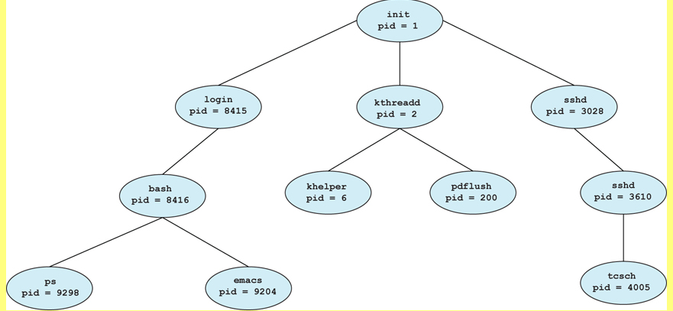
Sample Tree of Processes in Linux
On typical LINUX systems the process scheduler is termed sched, and is given PID 0. The first thing it does at system startup time is to launch init, which gives that process PID 1. Init then launches all system daemons and user logins, and becomes the ultimate parent of all other processes.
Dr.P.Subbulakshmi,VIT,Chennai
Notes:
Few points about the tree can be given

Slide 15

Process Creation (Cont.)
Address space
  Child duplicate of parent
  Child has a program loaded into it
UNIX examples
  fork() system call creates new process
  exec() system call used after a fork() to replace the process’ memory space with a new program
Dr.P.Subbulakshmi,VIT,Chennai

Slide 16

C Program Forking Separate Process
Dr.P.Subbulakshmi,VIT,Chennai

Slide 17

Creating a Separate Process via Windows API
Source: Operating_System_Concepts,_8th_ Edition
Dr.P.Subbulakshmi,VIT,Chennai
Notes:
Source to be mentioned

Slide 18
Process Termination
Process executes last statement and then asks the operating system to delete it using the exit() system call.
Parent may terminate the execution of children processes using the abort() system call. Some reasons for doing so:
  Child has exceeded allocated resources
  Task assigned to child is no longer required
  The parent is exiting and the operating systems does not allow a child to continue if its parent terminates
Dr.P.Subbulakshmi,VIT,Chennai

Slide 19
Process Termination
If a process terminates, then all its children must also be terminated.
  cascading termination. All children, grandchildren, etc. are terminated.
  The termination is initiated by the operating system.
The parent process may wait for termination of a child process by using the wait()system call. The call returns status information and the pid of the terminated process
pid = wait(&status);
If no parent waiting (did not invoke wait()) process is a zombie
If parent terminated without invoking wait , process is an orphan
Dr.P.Subbulakshmi,VIT,Chennai

Slide 20

Multiprocess Architecture – Chrome Browser
Many web browsers ran as single process (some still do)
  If one web site causes trouble, entire browser can hang or crash
Google Chrome Browser is multiprocess with 3 different types of processes:
  Browser process manages user interface, disk and network I/O
  Renderer process renders web pages, deals with HTML, Javascript. A new renderer created for each website opened
    Runs in sandbox restricting disk and network I/O, minimizing effect of security exploits
  Plug-in process for each type of plug-in
Dr.P.Subbulakshmi,VIT,Chennai
Notes:
Last point is hidden behind the image,can be made more clear

Slide 21
References
Abraham Silberschatz, Peter B. Galvin, Greg Gagne-Operating System Concepts, Wiley (2018).
Dr.P.Subbulakshmi,VIT,Chennai

Slide 22
THANK YOU
Dr.P.Subbulakshmi,VIT,Chennai

